Slide 1

ParkPal – Smart Parking, simplified
Researcher & Designer:
Soorya Prakash R (2023503502)
Kirubakaran V (2023503546)
Perumall rishi P (2023503551)
Sowmiya Narayanan (2023503582)
Dharanidharan L (2023503508)
Sibichakaravarthi (2023503027)

Slide 2
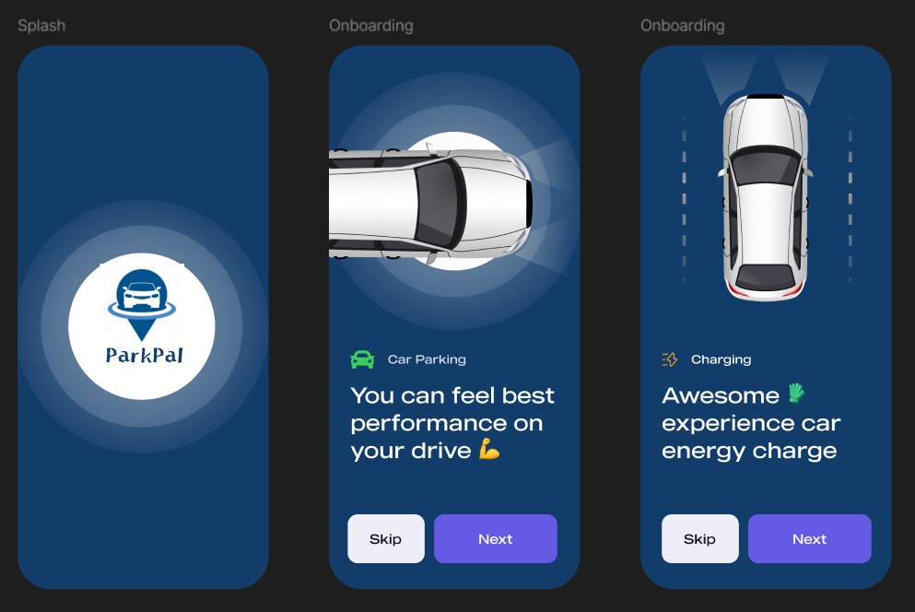
Jakob's Law
The onboarding process leverages Jakob's Law by using the standard mobile pattern of a horizontal scroll, clear dot indicators for position, and prominent "Skip" and "Next" buttons.
Users are already familiar with this interface from countless other apps, meaning they don't have to spend time learning how to navigate the introduction. This high level of familiarity reduces cognitive load and allows users to quickly proceed to the main functionality.

Slide 3
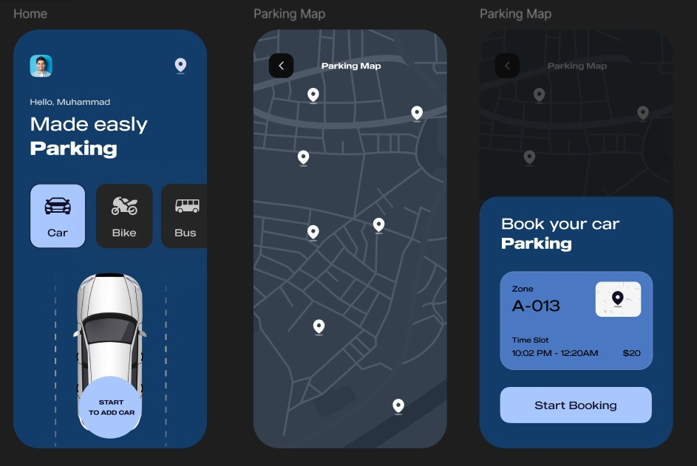
Fitt’s Law
The time to acquire a target is determined by its size and distance. The "Start Booking" button, located in the bottom action sheet, is designed as a large, full-width target. This ensures that the user, who is likely focused on the map, can quickly and accurately tap this most critical call-to-action with their thumb, minimizing errors and speeding up the essential booking process.

Slide 4
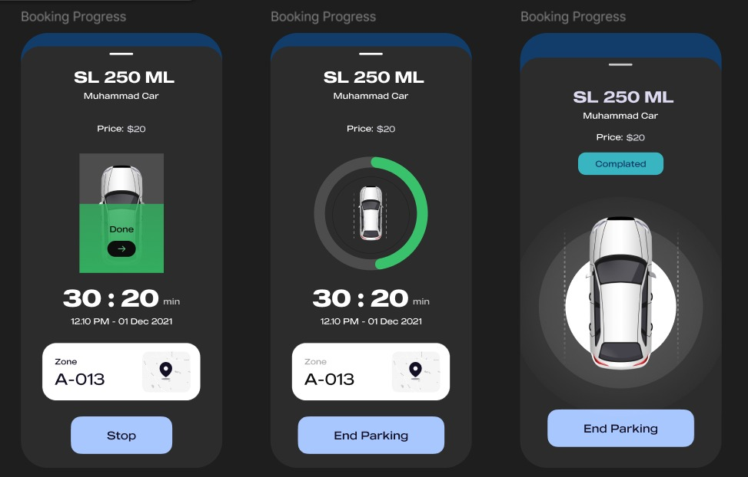
Visibility of System Status
Visibility of System Status is perfectly demonstrated on the 'Booking Progress' screens. The app provides continuous, real-time feedback through a prominently displayed, countdown timer (30:20 min) and a clear circular progress indicator around the car
Graphic.
By showing the user, the exact time remaining and the visual status (progress circle filling/unfilling), the system reassures them that their parking session is active and acknowledged, reducing anxiety and building immediate trust in the application's functionality.

Slide 5
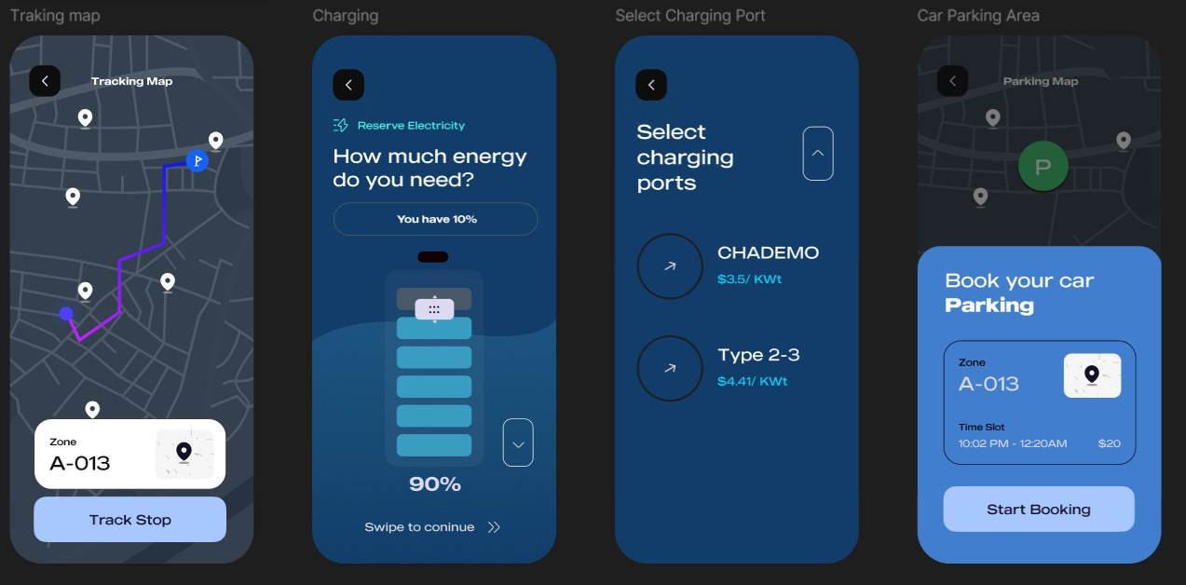
Hick’s Law
The more choices presented, the longer it takes to decide.
The 'Select Charging Port' screen only presents two distinct options: CHADEMO and Type 2-3. By limiting the available choices to the absolute necessary minimum and using large, clear labels for each, the app dramatically cuts down the user's decision time, maintaining a fast and efficient flow.

Slide 6
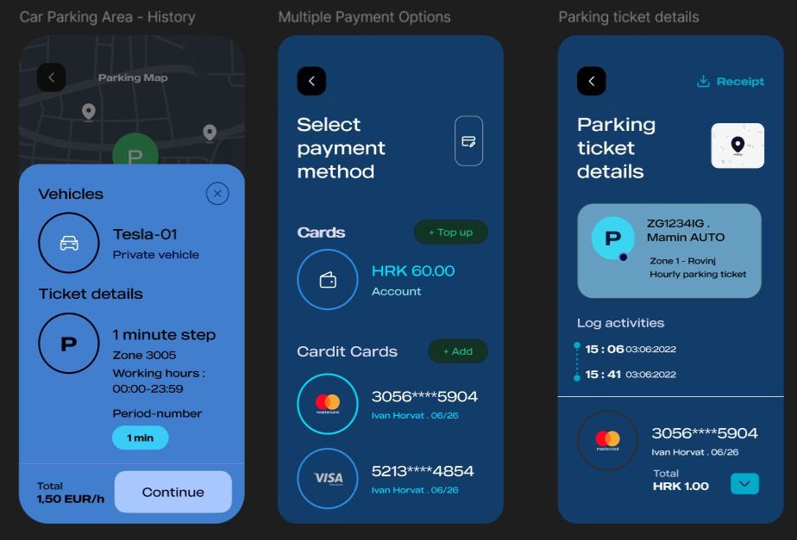
Law of Common Region
Elements within the same boundary are perceived as being grouped together. On the 'Multiple Payment Options' screen, each credit card (Mastercard and VISA) is contained within a clearly defined, rounded card shape. This boundary instantly groups the card number, type, and expiration date as a single, selectable option, making the list easy to scan and the different payment methods immediately distinct from one another.

